Slide 1


Keylogger And Security
PADAMALA KARTHEEK

Slide 2

KEYLOGGER AND SECURITY

Slide 3
Agenda
A keylogger is a type of malware that records keyboard inputs and sends that information back to the person controlling it. The agenda of a keylogger is to log keystrokes on a computer or mobile device, capturing sensitive information such as:
Passwords
Account information
Emails
Searches
Personal information

Slide 4
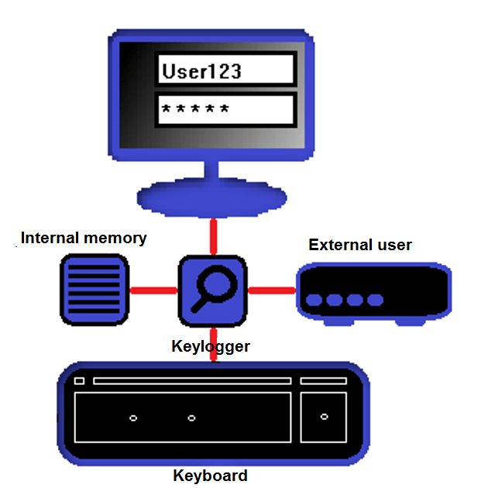
How Keylogger Works
Keyloggers intercept and record keystrokes before they reach the operating system.
They can also capture screenshots, track clipboard activity, and log website visits.
Some keyloggers can send the recorded data to a remote server for monitoring.

Slide 5
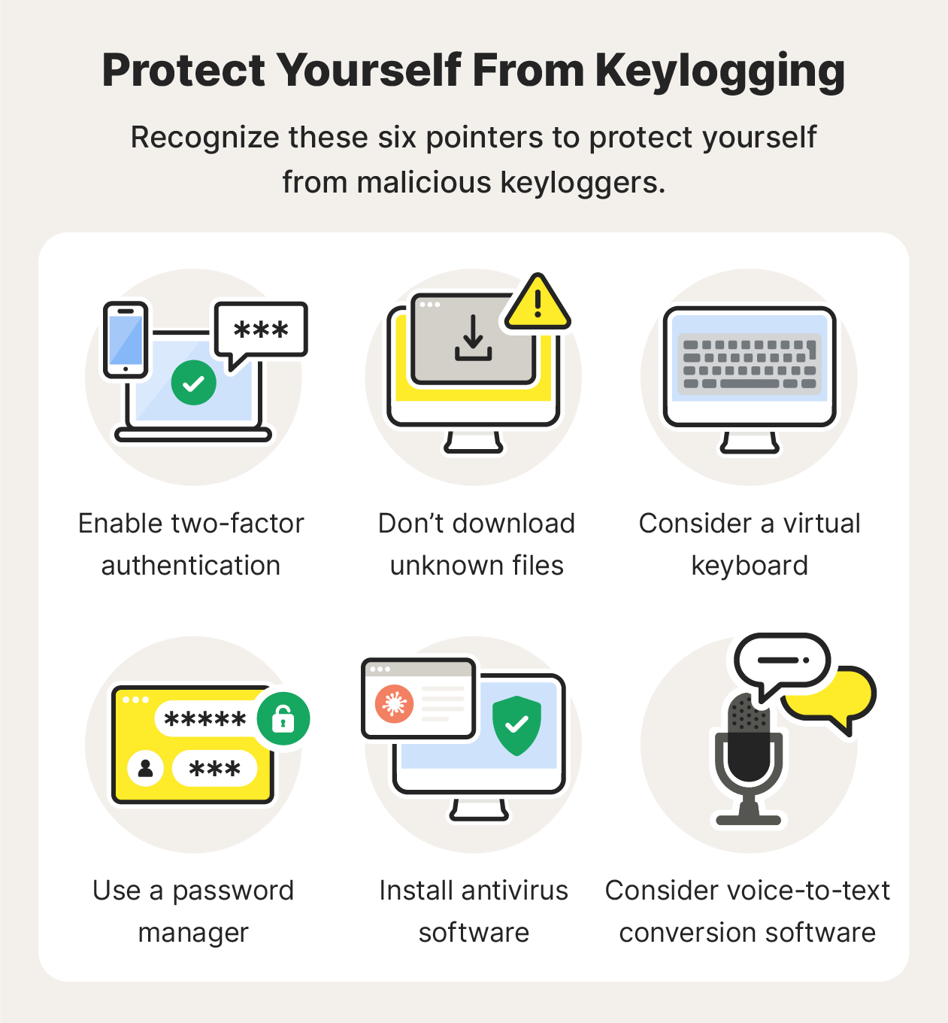
Types of Keyloggers
Software keyloggers are installed on a computer without the user's knowledge.
Hardware keyloggers are physical devices inserted between the keyboard and the computer.
Wireless keyloggers can capture keystrokes transmitted over Wi-Fi or Bluetooth connections.

Slide 6
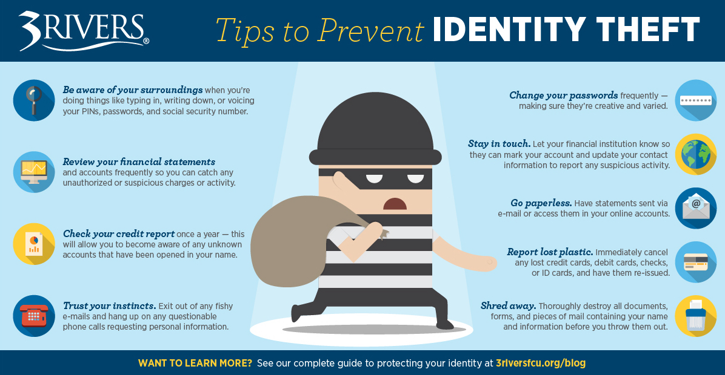
Advantages Of Keylogger
Keyloggers can lead to identity theft, financial fraud, and privacy breaches.
They can be used by hackers to steal sensitive information without the user's knowledge.
Employers and parents should use keyloggers ethically and legally to avoid invasion of privacy.

Slide 7
Disadvantages Of Keylogger
Legal issues: The use of keyloggers without consent can be illegal, and can lead to legal consequences.
Data breaches: Keyloggers can be used to steal sensitive information, which can lead to data breaches and identity theft.
Loss of trust: Keyloggers can erode trust between individuals and organizations, as individuals may feel that their privacy is being invaded.

Slide 8
Overview
keyloggers are a serious threat to computer security, and it is crucial to be aware of their existence and take steps to protect against them. By understanding how they work and taking proactive measures to prevent their installation, you can help keep your personal and professional data safe from unauthorized access.

Slide 9
Who Are The End User’s..?
Cybercriminals: Malicious individuals use keyloggers to steal sensitive information such as passwords, credit card numbers, and personal data for illegal activities like identity theft, financial fraud, and espionage.
Spies: Keyloggers are used by spies to gather information about individuals, organizations, or governments without their knowledge or consent.
Law Enforcement: Law enforcement agencies use keyloggers to monitor and gather evidence in criminal investigations, such as tracking down cybercriminals or monitoring organized crime groups.
IT Professionals: IT professionals use keyloggers to troubleshoot technical issues, monitor network usage, and detect malware infections in a legal and ethical manner.
Families and Businesspeople: Some families and businesspeople use keyloggers legally to monitor network usage, track employee activity, or monitor children’s online activities without their direct knowledge.

Slide 10
Solutions And It’s Preposition
Software Solutions :
Anti-Malware Software: Install reputable anti-malware software that specifically targets keyloggers, such as Malwarebytes, Avast, or Kaspersky. These programs can detect and remove keyloggers from your device.
Keylogger Detection Tools: Use specialized keylogger detection tools like Keylogger Detector or KeyScout to scan your device for keyloggers.
Hardware Keyloggers: Use hardware keyloggers that can detect and block keyloggers, such as the Keylogger Detector or the Kaspersky Keylogger.
USB Keyloggers: Use USB keyloggers that can detect and block keyloggers on USB devices.
Hardware Solutions :

Slide 11
The Wow In My Solutions
Keylogger Detection Tools
USB Keyloggers

Slide 12
Results
I had successfully verified and observed the working principle of “KEYLOGGER”
by software keylogger execution.

Slide 13


